Slide 1
Predicting severe collisions in traffic

Slide 2
Everyone has an interest in avoiding severe traffic collisions
Policy makers and public officials would want to know how to minimize them
Carmakers are also interested in making their cars safer
Developers would be interested in predicting collisions, so as to notify drivers in real time.

Slide 3
Data Acquisition and Cleaning
3 datasets from : https://www.data.gouv.fr/en/datasets/base-de-donnees-accidents-corporels-de-la-circulation/
130169 rows, 44 features
Missing values were dropped
12 features kept for analysis

Slide 4
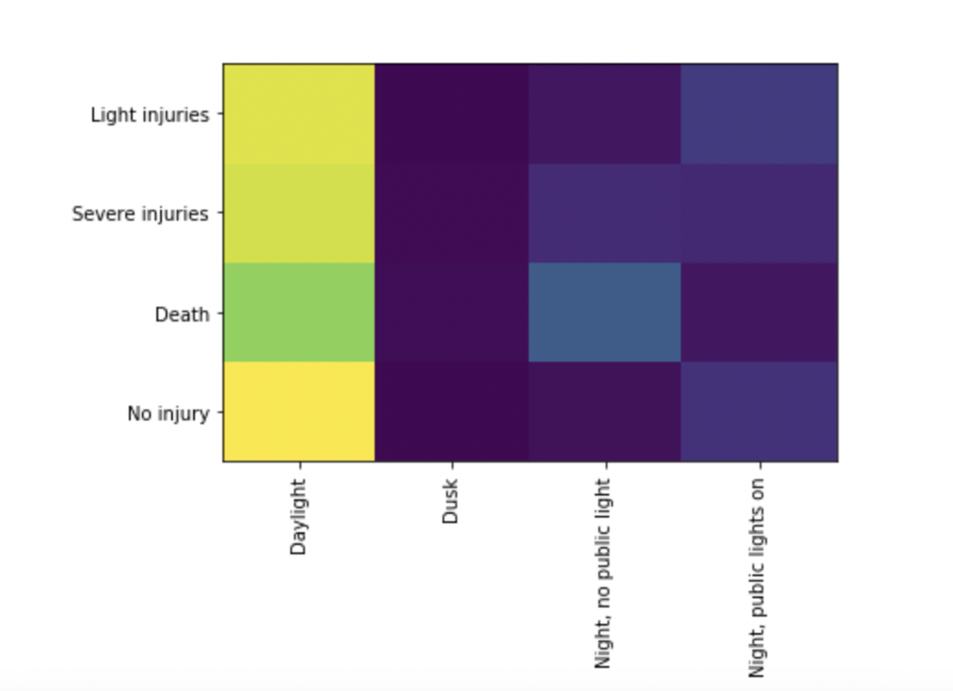
Deadly collisions are more relatively more frequent in dark conditions
Fewer deaths in daylight
More deaths in obscurity

Slide 5
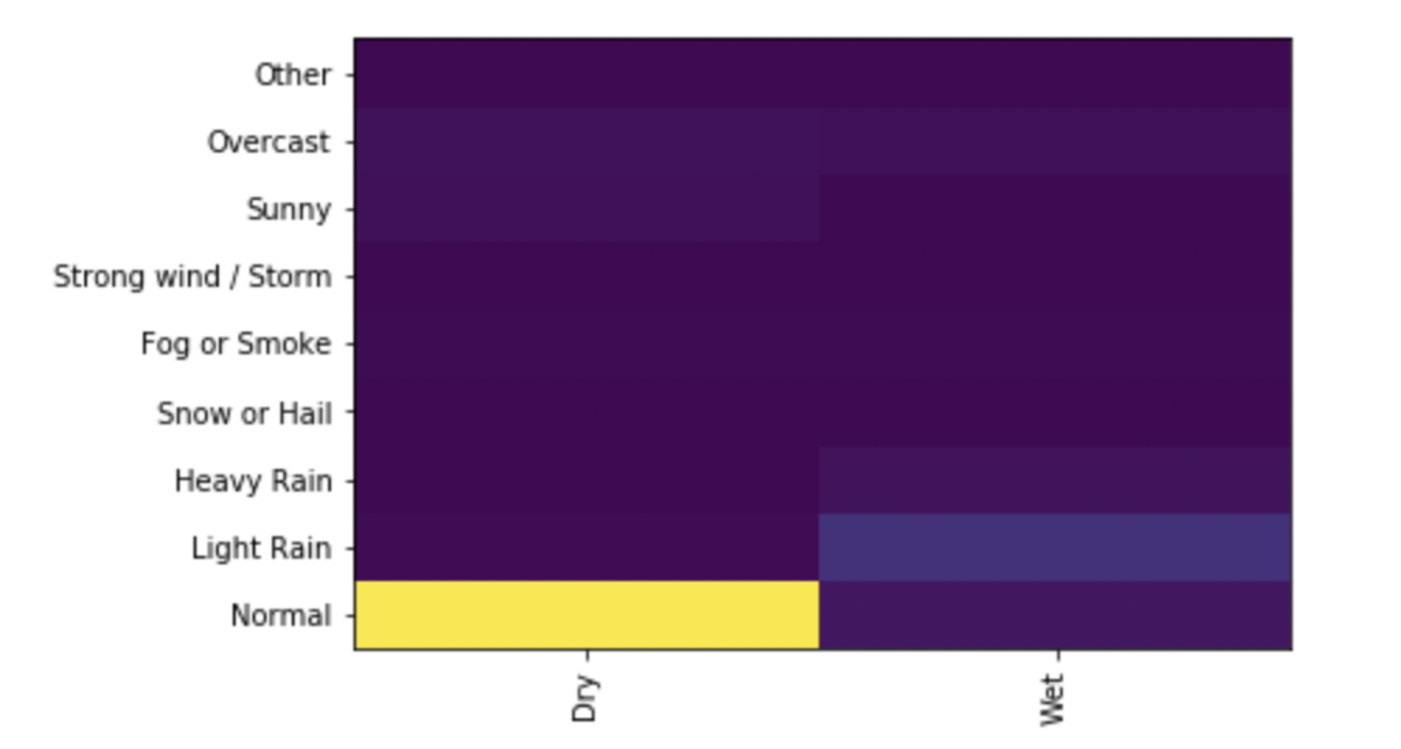
Deadly collisions are more relatively more frequent in dark conditions
Light rain seems conducive to collisions more than heavier weather
Most collisions occur in daylight, on dry roads.

Slide 6
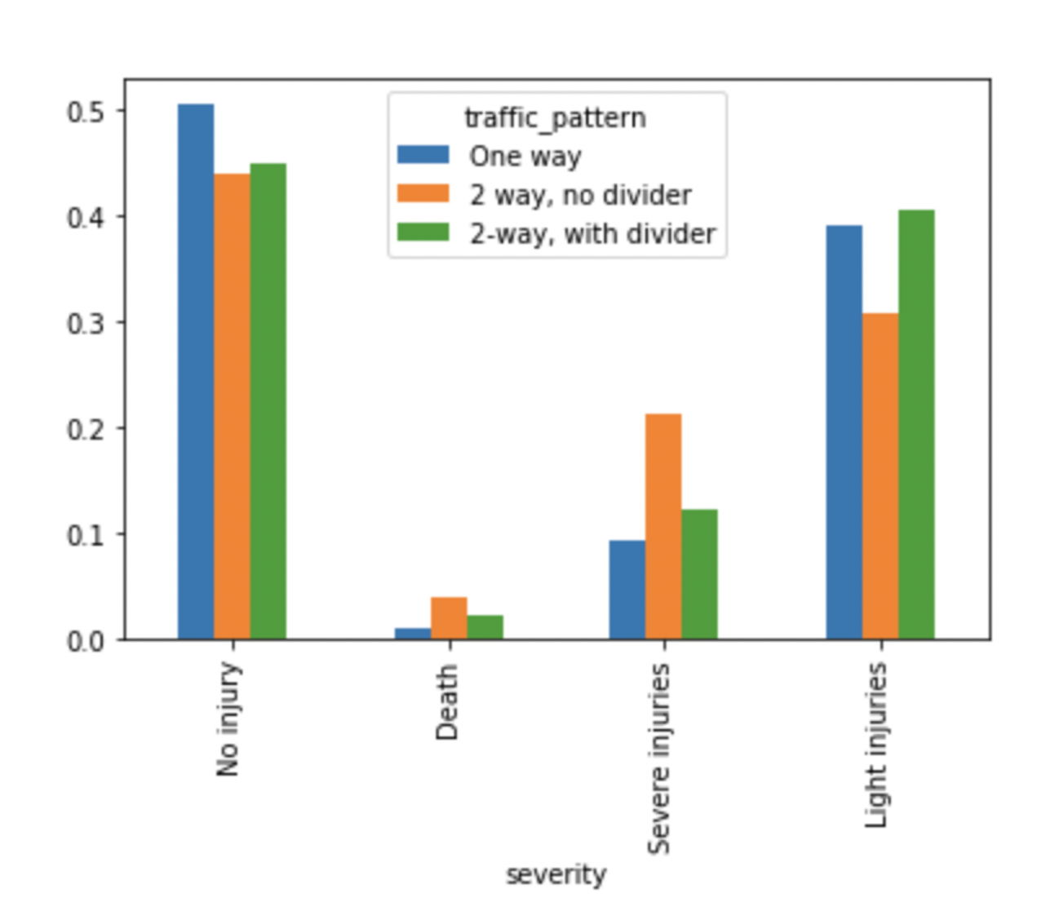
2-way roads with no dividers are the most dangerous
One-way roads (or roads with divider) are safer and injuries are less severe
Lethal and severe–injury collisions occur more frequently on 2-way roads with no divider – probably frontal collisions

Slide 7
Performance
Model performance is average, suggesting that the data and features available do not play a big role in severe collisions.
Model | Jaccard_similarity_score
Logistic Regression | 0.6777070063694267
Decision Trees | 0.6837250164726554

Slide 8
Conclusion and future directions
Most collisions occur on dry road with normal weather. Possible other factors:
Inattention
Traffic density
Two way traffic with no divider led to a higher share of severe collisions
More data could be used (average traffic data e.g.)
Real-time scoring could be done if:
Phone apps monitor driving and distractions, as well as location and speed
Car sensors work with phone to provide traffic and road data
Alerts go off accordingly

